Slide 1


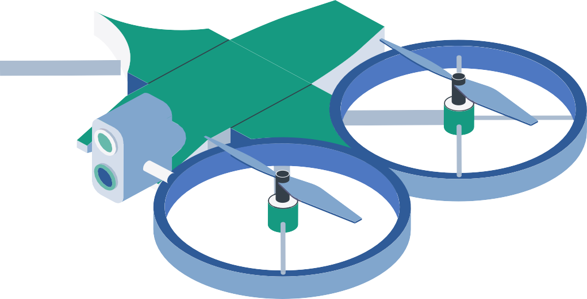


LEVERAGING ARTIFICIAL INTELLIGENCE IN DRONE DELIVERY SYSTEMS
LCE 116
Dimitris Chambi - 30727 George Karios - 30738 Lecturer: Dimitrios Boglou

Slide 2

TABLE OF CONTENTS
01
02
WHAT ARE
AI-DRIVEN DRONE DELIVERIES?
03
BUSINESS APPLICATIONS & BENEFITS
INTRODUCTION
04
CHALLENGES & CONSIDERATIONS
05
06
CONCLUSION
BIBLIOGRAPHY

Slide 3



01
INTRODUCTION

Slide 4
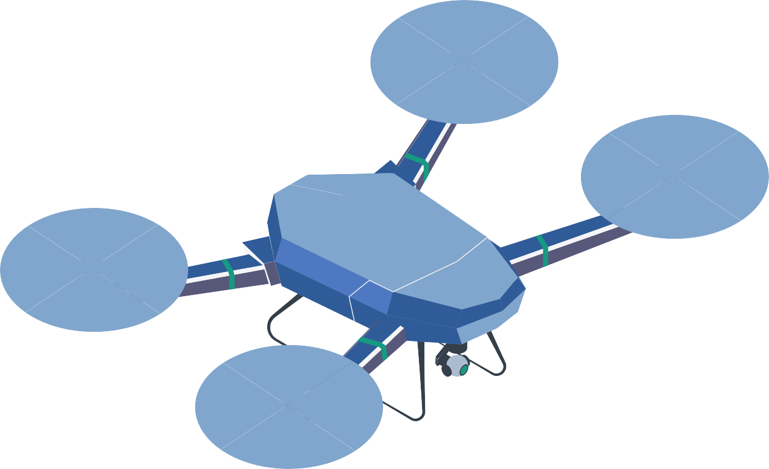

PARTS OF A DRONE
MOTOR
Powers the propellers and controls movement.
PROPELLER
Spins to lift and move the drone.
RECEPTOR
Receives signals and
sends them to the AI for decisions.
CAMERA
Used by the AI to see and make flight decisions.
LANDING GEAR
Protects the drone during
takeoff and landing.
DELIVERY PACKAGE
The Package that the Drone Delivers to the Client.

Slide 5
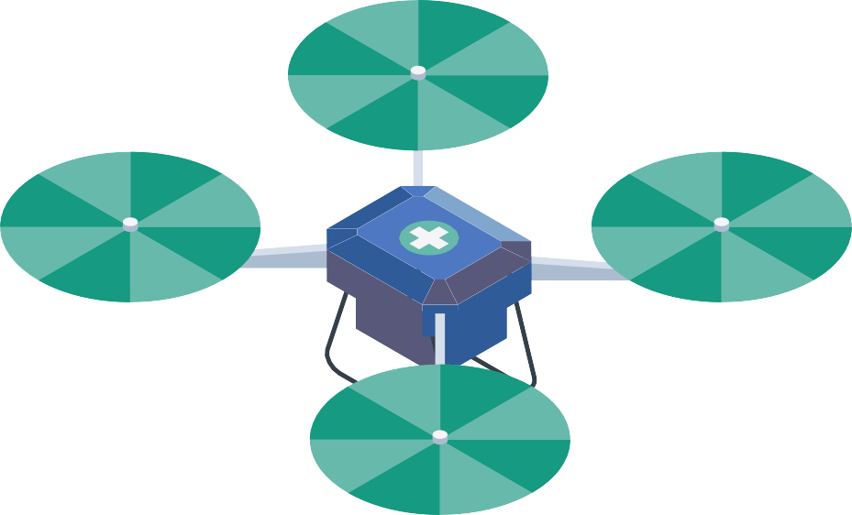

2.14B online shoppers in 2021→Demand for faster deliveries Businesses race to meet soaring expectations for deliveries
PURPOSE
Cut costs, speed last-mile delivery with AI-driven drones
Key AI features: navigation, real-time routing, predictive analytics
RELEVANCE
Gain a competitive edge & attract tech-savvy customers Boost customer satisfaction with faster, reliable deliveries Promote innovation & sustainability in modern business

Slide 6


02
WHAT ARE AI-DRIVEN DRONE DELIVERIES?

Slide 7


DEFINITION
Drones (unmanned aerial vehicles) equipped with AI for autonomous or semi- autonomous flight, route optimization, and decision-making.
Computer Vision:
Uses cameras & sensors to detect obstacles, read terrain, and ensure safe navigation.
Machine Learning & Deep Learning:
Real-time data processing for route optimization, obstacle avoidance, and predictive maintenance.
Edge Computing
Onboard processing to reduce latency and make faster decisions mid-flight.

Slide 8



03
BUSINESS
APPLICATIONS & BENEFITS

Slide 9



Last-Mile Delivery Optimization
Supply Chain & Logistics
Automates internal logistics (e.g. warehouse transfers)
Cuts delivery time with AI- optimized routes (avoids traffic)
Reaches remote locations quickly for on-time delivery
Streamlines inventory movement & fulfillment
Lowers costs (fuel, labor)

Slide 10

Data-Driven Decision Making
Competitive Advantages
Distinguishes businesses with cutting-edge service
Collects real-time delivery data
AI insights for route optimization & resource allocation
Enhances forecasting & continuous improvements
Faster deliveries → higher customer satisfaction
First-mover advantage & innovative brand image

Slide 11


04
CHALLENGES &
CONSIDERATIONS

Slide 12

Regulations & Airspace Control
Varying rules on where and how drones can fly Compliance with aviation authorities is crucial
Infrastructure & Tech Gaps
Need secure landing hubs, recharging stations, or “drone lanes”
AI relies on high-quality data
and stable communications
Security & Privacy
Potential hacking or misuse of drones
Privacy concerns over
flights near private property
Public Acceptance
Noise, safety worries, and public trust factor into success Address local concerns to gain community support

Slide 13





CONCLUSION
05

Slide 14

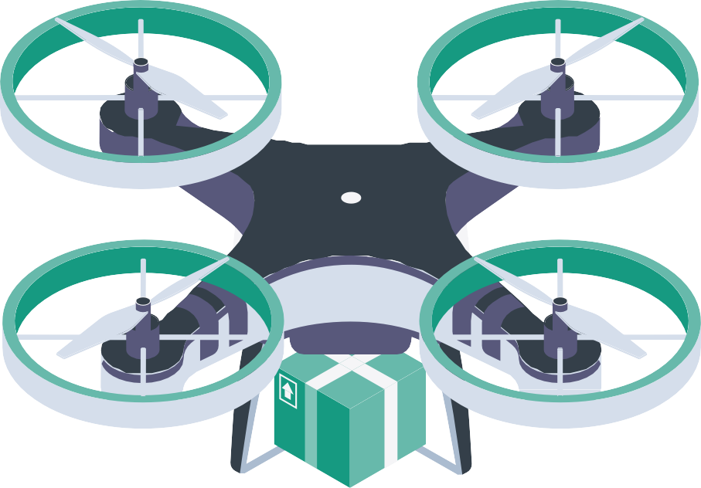

Summary
Looking Ahead
AI-driven drone delivery can drastically increase speed, reduce costs, and boost competitive advantage.
Call to Action
Urge business leaders, policymakers, and customers to invest in research, infrastructure, and pilot programs to refine drone technology and expand its benefits.
As technology matures
drones
and could
regulations adapt,
become standard in supply chain operations.

Slide 15
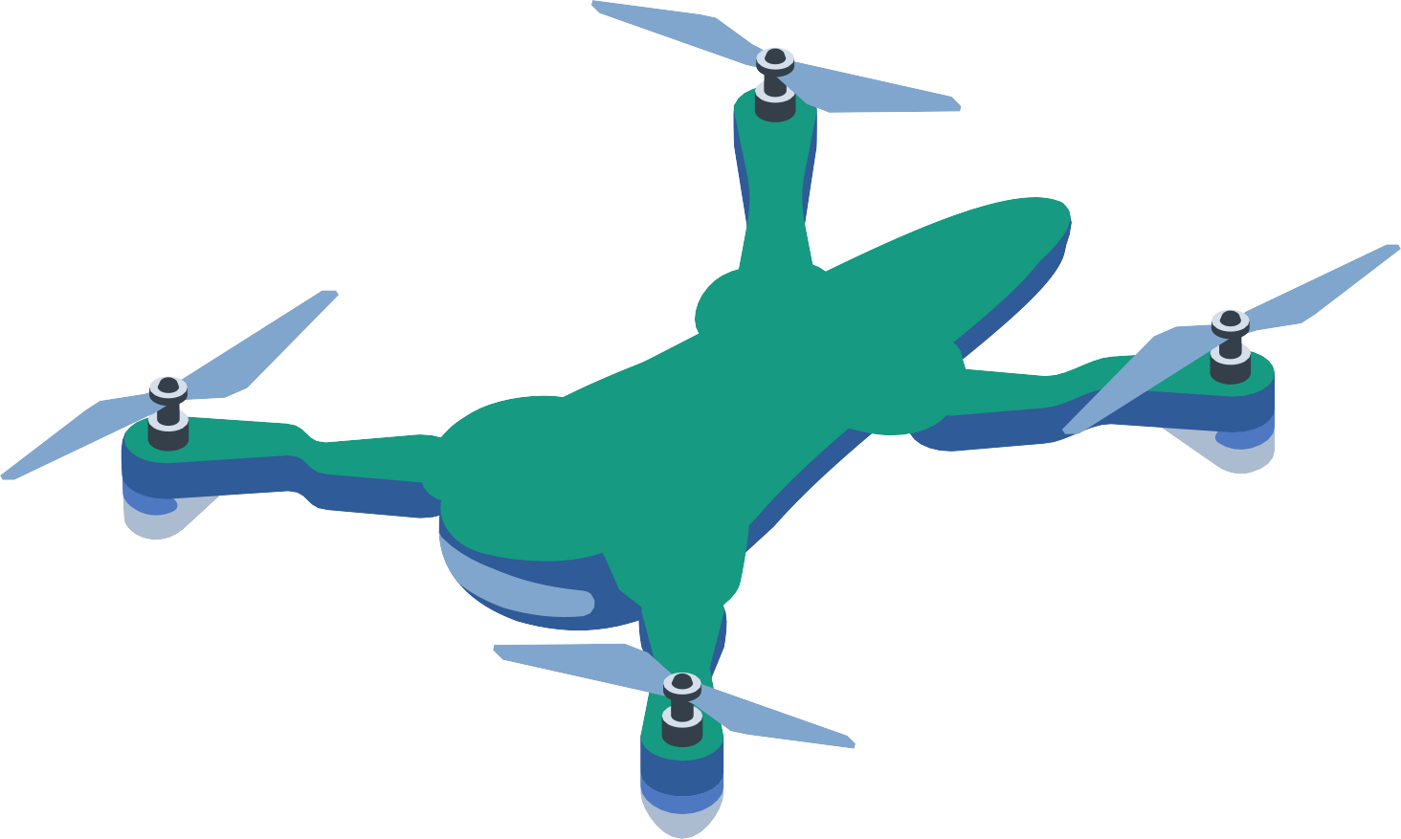

06
BIBLIOGRAPHY & REFERENCES

Slide 16


L. C. Dieu, “AI and Autonomous Drones: Transforming Delivery and Transportation | SmartDev,” SmartDev, Sep. 17, 2024. https://smartdev.com/ai-and-autonomous-drones-transforming-delivery-and- transportation/ (accessed Apr. 04, 2025).
SwissCognitive Guest Blogger, “How AI Is Transforming Drone Delivery,” SwissCognitive | AI Ventures, Advisory & Research, Aug. 13, 2024. https://swisscognitive.ch/2024/08/13/how-ai-is-transforming-drone-
delivery/ (accessed Apr. 04, 2025).
F. Magdolna, “Is Drone Delivery Artificial Intelligence? (April 2025),” Fly Eye, Jan. 19, 2024. https://www.flyeye.io/is-drone-delivery-artificial-
intelligence/# (accessed Apr. 04, 2025).
D. Caballero-Martin, J. M. Lopez-Guede, J. Estevez, and M. Graña, “Artificial Intelligence Applied to Drone Control: A State of the Art,” Drones, vol. 8, no. 7, pp. 296–296, Jul. 2024,
https://doi.org/10.3390/drones8070296.(accessed Apr. 04, 2025).

Slide 17
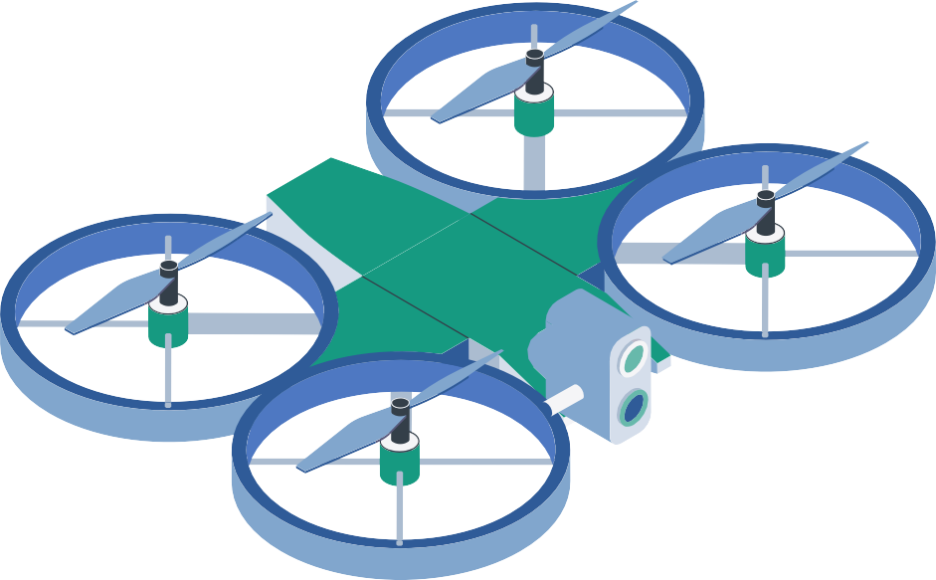

T. Verbitskaya, “AI Drones Streamlining Delivery and Supply Chain Management,” Keymakr, Jan. 20, 2025. https://keymakr.com/blog/untitled-4/
(accessed Apr. 05, 2025).
Y. ADEOYE, F. ONOTOLE, T. OGUNYANKINNU, G. AIPOH, A.
OSUNKANMIBI, and J. EGBEMHENGHE, “Artificial Intelligence in Logistics and Distribution: The function of AI in dynamic route planning for transportation, including self-driving trucks and drone delivery systems,” World Journal of Advanced Research and Reviews, vol. 25, no. 2, pp. 155–167, Feb. 2025, doi: https://doi.org/10.30574/wjarr.2025.25.2.0214.(accessed Apr. 05,
2025).
W. Walker, “Drones, AI and more: 5 Last-mile delivery trends to watch | Roadie,” Roadie, Oct. 28, 2024. https://www.roadie.com/blog/2024/10/drones- ai-and-more-5-last-mile-delivery-trends-to-watch-ent (accessed Apr. 05, 2025).
D. Amicone, A. Cannas, A. Marci, and G. Tortora, “A Smart Capsule Equipped with Artificial Intelligence for Autonomous Delivery of Medical Material through Drones,” Applied Sciences, vol. 11, no. 17, p. 7976, Aug. 2021, doi: https://doi.org/10.3390/app11177976.(accessed Apr. 05, 2025).

Slide 18


R. Nunkoo, R. Pillai, Brijesh Sivathanu, and N. P. Rana, “Drivers and inhibitors of consumers’ adoption of AI-driven drone food delivery services,” International Journal of Hospitality Management, vol. 123, pp. 103913– 103913, Sep. 2024, doi: https://doi.org/10.1016/j.ijhm.2024.103913.
(accessed Apr. 06, 2025).
A. S. Shuaibu, A. S. Mahmoud, and T. R. Sheltami, “A Review of Last- Mile Delivery Optimization: Strategies, Technologies, Drone Integration, and Future Trends,” Drones, vol. 9, no. 3, p. 158, Feb. 2025, doi:
https://doi.org/10.3390/drones9030158.(accessed Apr. 06, 2025).

Slide 19



THANK YOU!
DO YOU HAVE ANY QUESTIONS?

